Slide 1
DB2 Constraints
DB2 Training class 07

Slide 2
Introduction to Constraints
Constraints are used to limit the type of data that can go into a table. Constraints can be specified when a table is created (with the CREATE TABLE statement) or after the table is created (with the ALTER TABLE statement).
We will focus on the following constraints:
      NOT NULL
      UNIQUE
      CHECK
      DEFAULT
      PRIMARY KEY
      FOREIGN KEY

Slide 3
NOT NULL Constraint
The null value is used in databases to represent an unknown state.
The NOT NULL constraint is used to ensure that a given column of a table is never assigned the null value.
Once a NOT NULL constraint has been defined for a particular column, any insert or update operation that attempts to place a null value in that column will fail.
CREATE TABLE EMPLOYEES (. . . EMERGENCY_PHONE CHAR(14) NOT NULL, . . . );

Slide 4
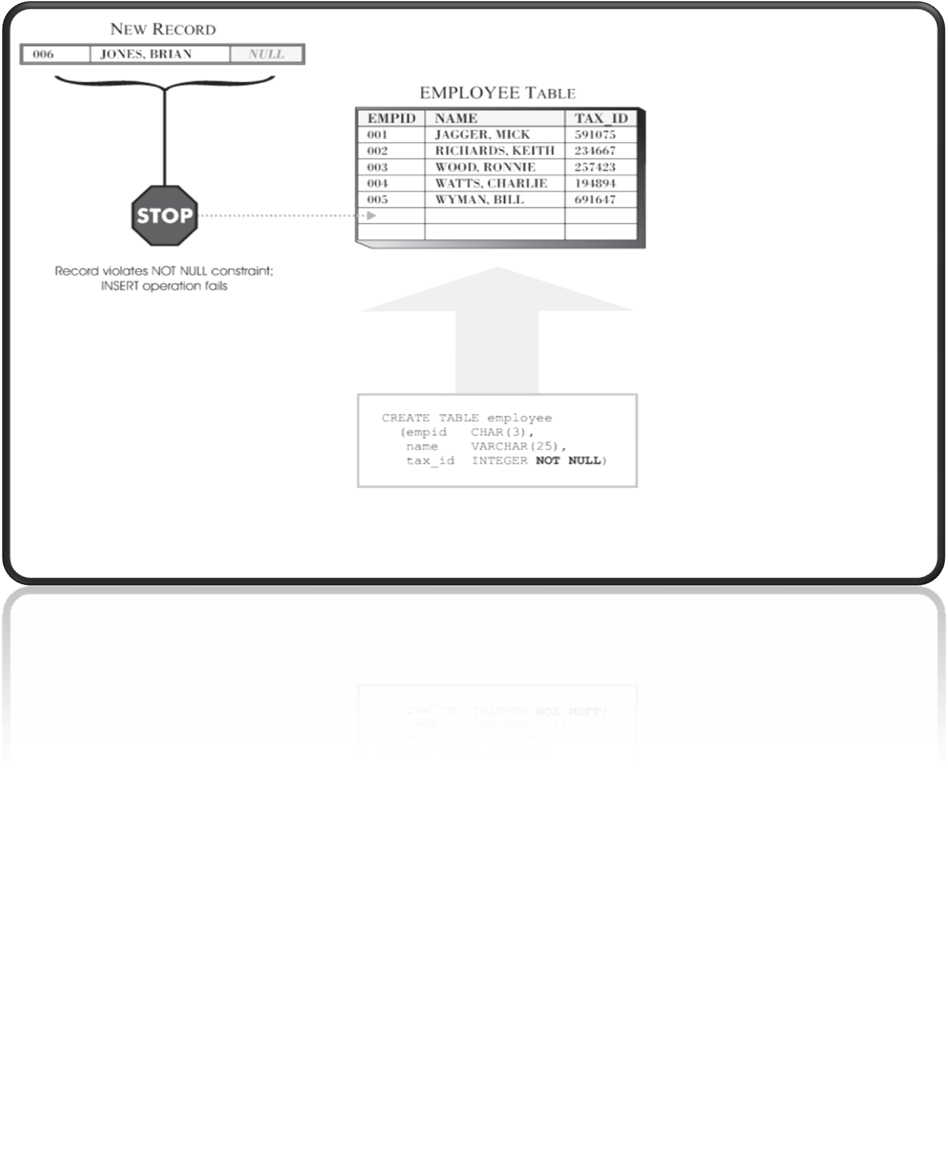
NOT NULL Constraint

Slide 5
UNIQUE Constraint
UNIQUE CONSTRAINTS ensure that the values in a set of columns are unique and not null for all rows in the table. The columns specified in a unique constraint must be defined as NOT NULL.
Unique constraints can be defined in the CREATE TABLE or ALTER TABLE statement using the UNIQUE clause.
Regardless of when a UNIQUE constraint is defined, when it is created, the DB2 Database Manager looks to see whether an index for the columns to which the UNIQUE constraint refers already exists.
There is a distinction between defining a UNIQUE constraint and creating a unique index. Even though both enforce uniqueness, a unique index allows NULL values and generally cannot be used in a referential constraint. A UNIQUE constraint, on the other hand, does not allow NULL values, and can be referenced in a foreign key specification.

Slide 6
DEFAULT CONSTRAINT
the default constraint can be used to ensure that a particular column in a base table is assigned a predefined value (unless that value is overridden) each time a record is added to the table.
The predefined value provided could be null (if the NOT NULL constraint has not been defined for the column)
OR
A user-supplied value compatible with the column's data type, OR
A value furnished by the DB2 Database Manager

Slide 7
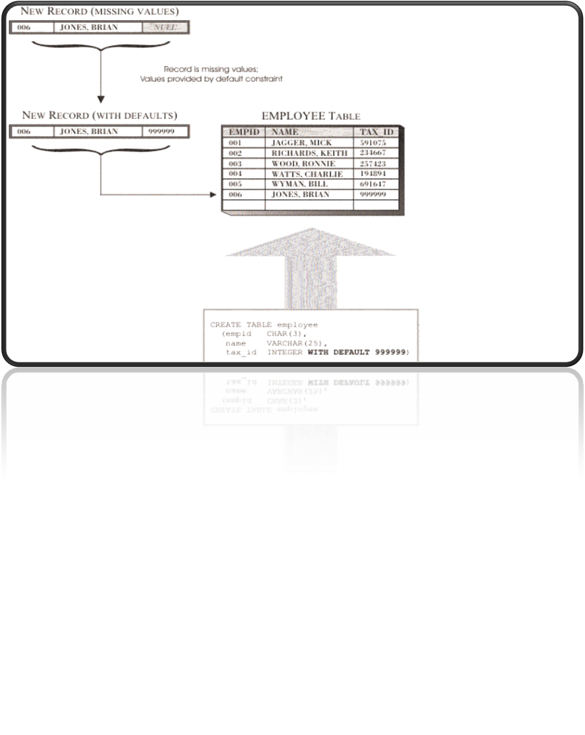
DEFAULT Constraint

Slide 8
CHECK CONSTRAINT
The CHECK constraint is used to limit the value range that can be placed in a column.
If you define a CHECK constraint on a single column it allows only certain values for this column.
If you define a CHECK constraint on a table it can limit the values in certain columns based on values in other columns in the row.
CREATE TABLE PERSONS
(
E_ID INT NOT NULL CHECK (E_ID>0),
LASTNAME VARCHAR(255) NOT NULL,
FIRSTNAME VARCHAR(255),
ADDRESS VARCHAR(255),
CITY VARCHAR(255)
)

Slide 9
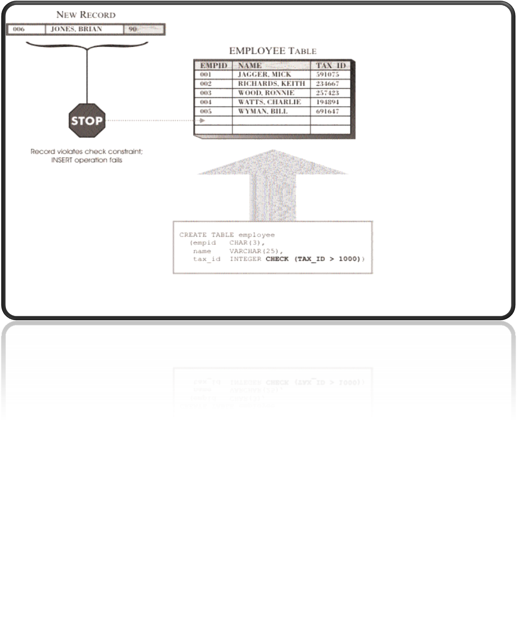
CHECK CONSTRAINT

Slide 10
PRIMARY KEY Constraint
The PRIMARY KEY constraint uniquely identifies each record in a database table.
Primary keys must contain unique values.
A primary key column cannot contain NULL values.
Each table should have a primary key, and each table can have only ONE primary key.
CREATE TABLE album(
id CHAR(10) NOT NULL PRIMARY KEY,
title VARCHAR(100),
artist VARCHAR(100)
);

Slide 11
FOREIGN KEY Constraint
Foreign Keys are keys used in a table as an attribute and are primary keys of some other table
These are attributes of one table that have matching values in a primary key in another table, allowing for relationships between tables.
CREATE TABLE TRACK(
ALBUM CHAR(10),
DSK INTEGER,
POSN INTEGER,
SONG VARCHAR(255),
FOREIGN KEY (ALBUM) REFERENCES ALBUM(ID));

Slide 12
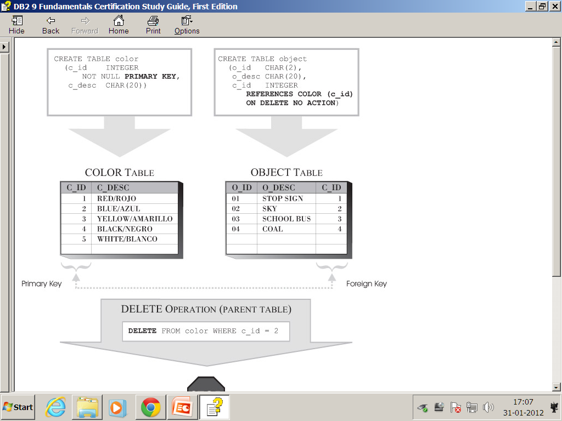
The Insert Rule for Referential Constraints

Slide 13
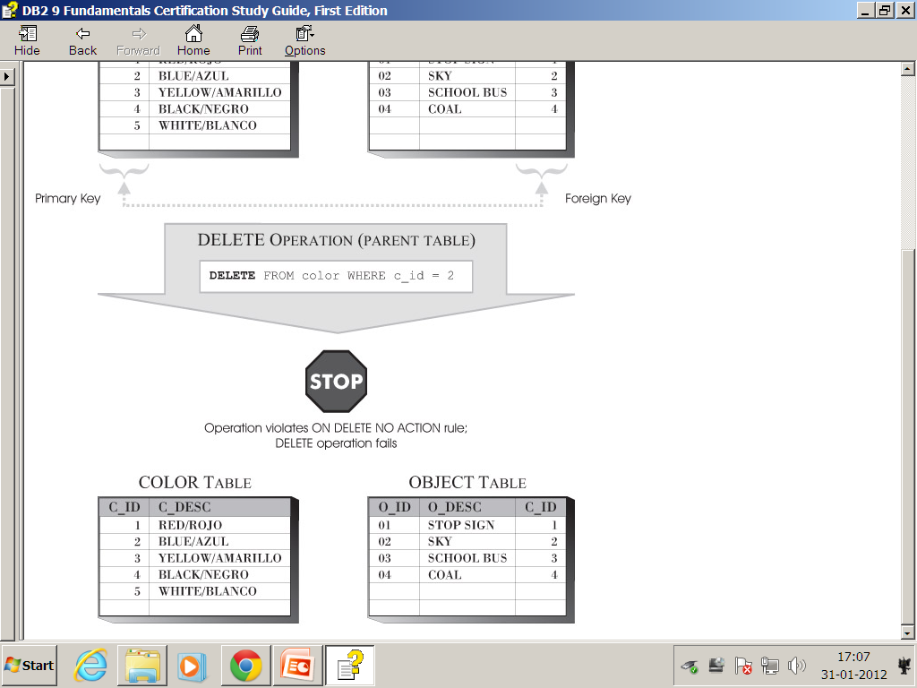
The Insert Rule for Referential Constraints

Slide 14
REFERENTIAL INTEGRITY
ON DELETE CASCADE:
If we delete the rows in a parent table then the related rows of dependent table will be deleted automatically.
ON DELETE SET NULL:
If we delete the rows of parent table then the foreign key values of the related rows in dependent table will set to nulls.
ON DELETE RESTRICT:
If we delete rows of parent table which are having matching foreign key values in dependent table then we will get SQL error -532.
In order to overcome this error we can delete the rows from dependent table first and then delete the rows from parent table.

Slide 15
Practical’s

Slide 16
Thank You

